Slide 1
Cardiac Device Malfunction and Radiation Therapy
Suzette Turner
Nurse Practitioner
Sunnybrook Health Sciences Centre
Amin Zagzoog
Cardiology Resident
University of Toronto

Slide 2
FACULTY/PRESENTER DISCLOSURE
Faculty: Amin Zagzoog , Suzette Turner
Relationships with commercial interests:
Grants/Research Support: None
Speakers Bureau/Honoraria: None
Consulting Fees: None
Notes:
This slide must be visually presented to the audience AND verbalized by the speaker.

Slide 3
Objectives
Understand the effects of radiation on CIED
Appreciate the rationale for guidelines based management
Review studies that influence current guidelines
Review standards of care
Notes:
Growth of radiotherapy increased over 200% 0ver the last decade- Zaremba 2015

Slide 4
Introduction
The number of patients requiring device therapy for cardiac conditions continues to increase
Radiation therapy is a very common treatment modality and a growing number of patients with cardiac devices are referred for radiation therapy as cancer incidence rates also continue to increase.

Slide 5
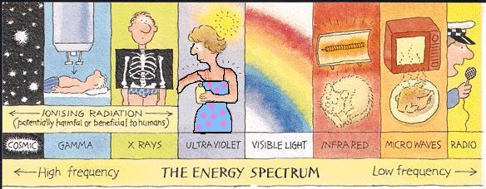
Forms of Radiation

Slide 6
Types of Radiation
External beam radiation (EBRT)
Internally- brachtyerapy(BT) – incorporates needles or catheters inserted into tumors at high or low dose rate (HDR BT/LDR BT)
Photons =gamma rays
Electrons
Protons
Neutrons
Ions

Slide 7
What is Radiation Treatment?
Radiation treatment is noninvasive local treatment using precise dose of ionizing radiation delivered to either malignant or nonmalignant tumor while sparing healthy tissue
Benefits include confinement of treatment side effects, preservation of function, and better cosmetic results than surgery
Also widely used in palliative treatments with 40-50% treatment administered with palliative intent,
(Washington & Lever; Kirkbridge, 1999)

Slide 8
LINAC- a linear accelerator

Slide 9
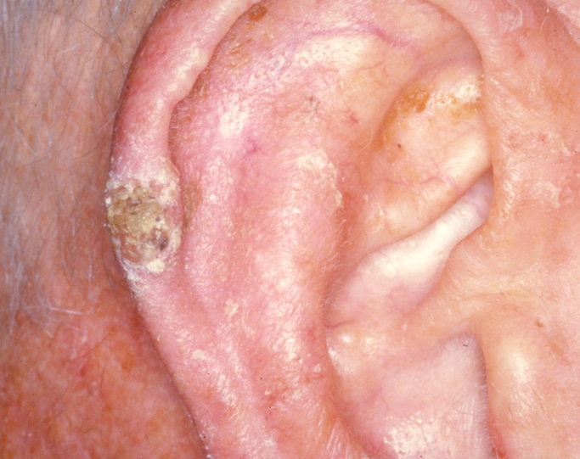
Case 1
86/M –right ear skin CA – tx with 9 mEV, 4500c0Gy in 10 fractions, – completed July 2015
SSS- DDD PPM- 2000/generator change 2010 -paced 75% of the time
He is not PPM dependent
His underlying HR is 40

Slide 10
Case 1
At the pre-planning, what would you recommend :
Too risky continue medical therapy
Explant PPM, perform radiation then re-implant
Reprogram to VOO for the duration of radiation
Evaluate pre and post

Slide 12
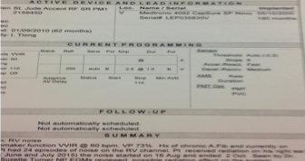

Slide 13
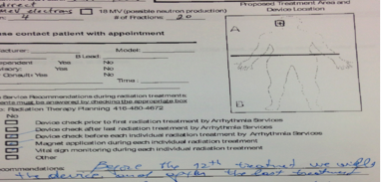

Slide 14
Radiation Damage

Slide 15
Mechanism of Damage
Ionizing Radiation -> excess electron hole pairs in the insulator layer of SiO2
Excess pairs rapidly recombine (1-10μs)
photocurrents - holes are attracted to defects and electrons can be detected as signal
Caused by exposure to direct or scatter radiation or EMI caused by the linear accelerator

Slide 16
Results of Damage
Program reset to default values
Program altered, incorrect values –influencing rate response values
Failure to pace
Impact related to patient dependency – palpitations, vertigo, syncope, arrhythmia, ventricular fibrillation
Inappropriate delivery of stimulus– approximately 10-20% of patients experience an unnecessary shock within a 5 year follow-up period
Crossley et al (2011) Heart Rhythm; 8,(7) 1114-54

Slide 17
Radiation Variables Related to Failure
Cumulative Dose
Neutrons
Energy
mEV (for superficial cancers- unpredictable, scattered energy
MV (normally used)
KV (orthovoltage for skin)
EMI

Slide 18
CIED
Pulse Generator
Sensing circuit
Timing circuit
Output circuit
Charge build up capacitor
Analog/digital
Charge build up capacitor
Random access memory
Battery
Leads
H. Weston Moses, James C. Mullin, A practical guide to cardiac pacing, 2007, p28
Last A. Radiotherapy in patients with cardiacpacemakers. Br J Radiol 1998; 71: 4–10.

Slide 19
Radiation damage to CIED
Most often occurs when a high energy neutron strikes the reversed biased p-n junction of a memory cell and causes enough charge to cause a change in memory
The most sensitive circuit -random access memory (RAM), due to the small amount of charge used to store device programming code and data
Disruption to the RAM circuitry may cause the RAM to lose the stored programming, altering individual programming or leading to an electrical reset of the device, referred to as power on reset (POR)
Transient interference is more likely attributed to EMI rather than radiation as the interference is only present during beam on times. Higher doses of radiation are more likely to cause significant damage, which may not be repaired by reprogramming
This effect may range from mild corruption of their programming to power-on-reset or complete failure of the device. The likelihood of damage increases with cumulative radiation exposure to the device
Tondato et al, 2009

Slide 20
Modes of Failure
Transient
Inhibition of pacing
False signal detection
Inappropriate pulse initiation
Repairable
Partial device reset
Total device reset
Change in sensing threshold
Change in pacing threshold/ required safety margin
Permanent
Loss of power
Loss of function
Change in battery charge time
Critical memory damaged (RAM)

Slide 21
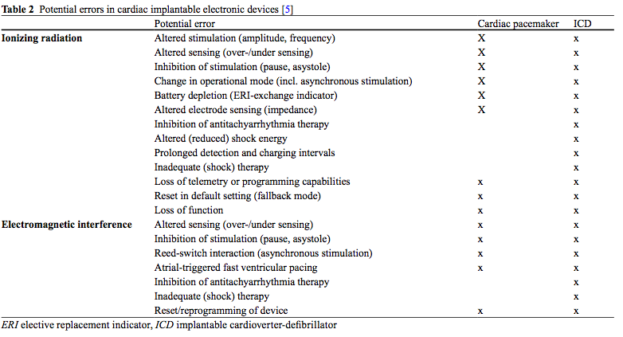
Potential Errors
Benjamin Gauter-Fleckenstein et al 2015

Slide 22
Potential Errors
Most frequently observed EMI influencing rate response algorithm
Resets – device returned to initial
Rare but more commonly caused by therapeutic radiation
Pulse generator damage or permanent failure
Damage of the lead tissue interface
Benjamin Gauter-Fleckenstein et al 2015

Slide 23
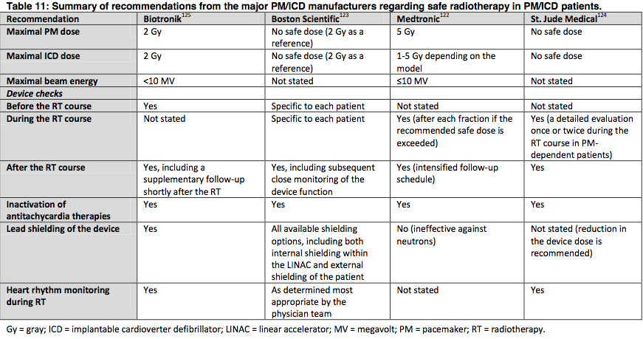
CIED Manufacturers
Zaremba , 2015

Slide 24
Radiation planning and treatment process
The absorbed dose of radiation measured in Gray (Gy) and calculated as one joule (J) of energy absorbed per Kg
Treatment administered from one day – 8 wks of daily tx or fractions
Conventional fractionations- daily doses of 1.8- 2Gy for radically or curatively treated patients
Higher doses (hyperfractionation) used in palliative cases to decrease tx time
Ling et al (2010) Radiotherapy and Oncology, 95(3), 261-­268.

Slide 25
Pre-Radiation
Identify the manufacturer
Identify dependency
Check capture, sensing thresholds and battery status
Deactivate therapies/ Monitor zone if indicated
Temporary pacing and defibrillation should be available

Slide 26
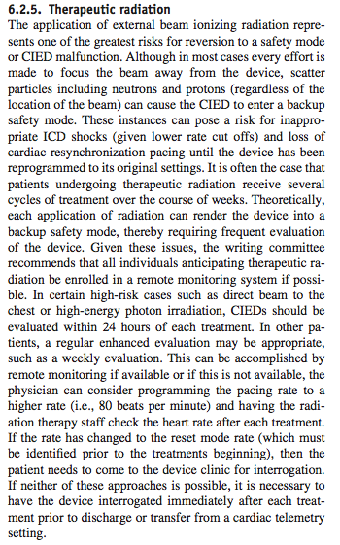
Heart Rhythm Consensus Statement 2011

Slide 27
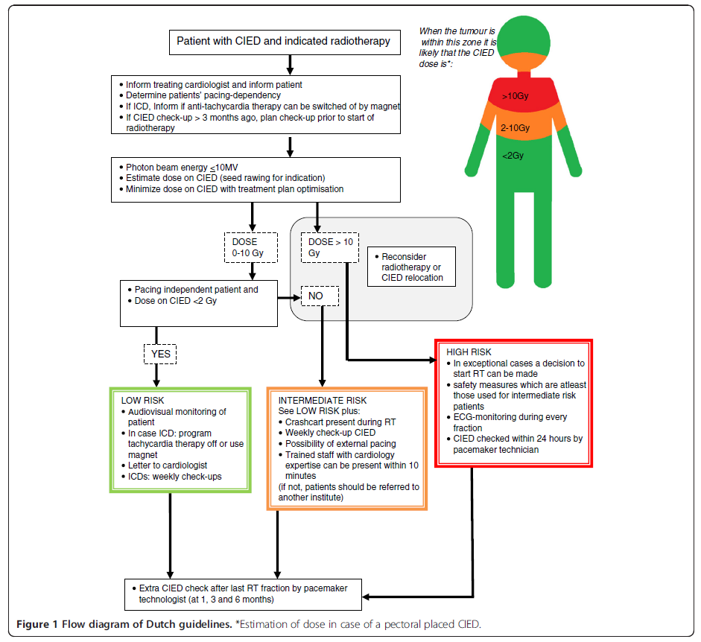
Hurkmans- Dutch Approach
Hurkmans et al 2012

Slide 28
Hurkman et al 2012

Slide 29
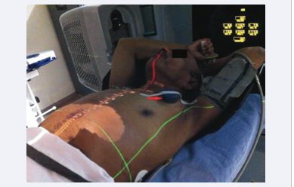
Magnet Placement

Slide 30
Case 2
71M requiring treatment for left lung cancer
He has a 4 year old prophylactic ICD
Scheduled for 6MV of curative radiation over 6 weeks

Slide 31
Case 2
At this point you recommend :
Too risky continue medical therapy
Explant ICD, perform radiation then re-implant
Continue as planned with radiation with magnet on ICD for treatment

Slide 32
Research
Purpose -to determine the prevalence of CIEDs among patients requiring RT and report the common CIED-related problems when patients are managed according to a standard clinical care path.

Slide 33
Study Population
261

Slide 34
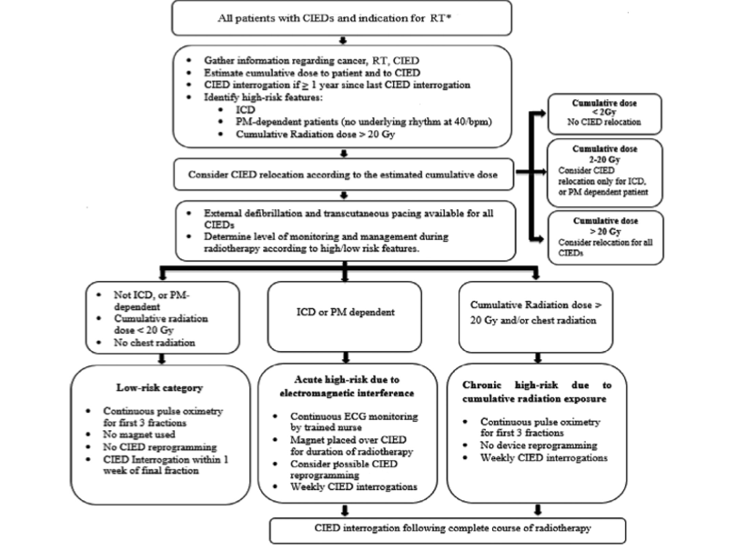
Brambatti-McMaster’s Approach

Slide 35
Treatment Region

Slide 36
Results
Of the 34,706 consecutive patients receiving RT, 261 patients (0.8%, mean age 77.9 9.4 years) had an implantable cardiac device: 54 (20.7%) ICDs and 207 (79.3%) PMs.
The site of RT was head and neck (27.4%), chest (30.0%), and abdomen/pelvis (32.6%).
Using our care path, 63.2% of patients required continuous cardiac monitoring, 14.6% required device reprogramming, 18.8% required magnet application during RT, and 3.4% required device repositioning to the contralateral side before RT.

Slide 37
Results cont
4 patients (1.5%) had inappropriate device function during RT:
3 experienced hemodynamically tolerated ventricular pacing at the maximum sensor rate
1 experienced a device power-on-reset.
No patient died or suffered permanent device failure.

Slide 38
Patients with Changes

Slide 39
Limitations
The main limitation of this analysis is that it is a single-center study; thus, the small sample size may limit ability to document rare CIEDs malfunctions due to RT.
However, to our knowledge, this is largest published series to validate a systematic policy of risk assessment and patient management of RT patient with CIEDs.
Not designed to test the efficacy of our standard clinical care path as all screened patients were risk stratified per the algorithm.
However, given the known risks of RT to CIEDs, a randomized trial would have been unethical

Slide 40
Disclaimer
“Given the uncommon nature of some adverse events, this study cannot provide definitive guidance for all scenarios but rather can serve as a starting point for future research in this area.
It can provide a foundation for institutional policy and clinical care path development, which will facilitate the safe administration of RT to patients with CIEDs”.

Slide 41
Case 3
88 year old gentleman with background history of metastatic prostate cancer.
Post radiation therapy has drop in his impedance to 260 ohms as well increase in his threshold from 1.25 MV @ 0.6 ms to 1.5 @ 0.6ms.

Slide 42
Case 3
The patient had riata lead which is on advisory?
What is the most likely cause of the malfunction:
The lead
Radiation Therapy
Both

Slide 43
Sunnybrook’s Approach
Identify the manufacturer
Identify dependency
Check capture, sensing thresholds and battery status
Deactivate therapies/ Monitor zone if indicated
Temporary pacing and defibrillation should be available

Slide 44
Case 4
69/M- BiVICD
Prostate Ca – Tx at a different facility 5000cGy in 25 fractions for phase 1 and 1600cGy in 8 fractions for phase 2. The dose all delivered is 6MV. Total maximum dose is 12cGy
In for weekly checks of BiVICD
At this point you recommend :
Continue radiotherapy
Explant ICD, perform radiation then re-implant
Continue as planned with radiation without magnet
Suggest to RT department the use of magnet during treatment

Slide 45
Incidence of Cardiac Rhythm Malfunction During Radiation Therapy

Slide 46
Methods
Severity and frequency was stratified as a function of the following:
‐ Device type
‐ Total device radiation dose and fractionation scheme
‐ Radiation therapy treatment modality and technique
‐ Energy of therapeutic radiation
‐ Anatomical location of radiation therapy treatment site

Slide 47
Methods
210 patients received radiation therapy at OCC between 2007 and 2015
33 patients with ICD
187 patients with PPM

Slide 48
Results
Case | Type of device | Location of Ca | Radiation dose | Energy beam | Type of malfunction/intervention
1 | ICD | R ear | 42 Gy | 6mEV | RV threshold increased
2 | BiVICD | Pelvis | 16Gy | 18MV | RV/LV/ threshold/lead impedance increased
3 | ICD | Pelvis | 76 Gy | 6MV | Decreased A/V sensing
4 | ICD | Scalp | 23 Gy | 6MV | Atrial undersensing
5 | PPM | Pelvis | 40 Gy | 6MV | RV lead noise
6 | PPM | L ear | 41 Gy | 6mEV | RV lead oversensing
7 | PPM | L humerus | n/a | 18MV | Device pocket change
8 | PPM | L chest | n/a | 6MV | Device pocket change
9 | PPM | L chest | 70Gy | 6MV | Frequent PMT Atrial sensing decrease

Slide 49
Conclusion
Through this retrospective study of 210 patients who underwent radiation therapy at the Sunnybrook Odette Cancer Center, 6 cases of device malfunction (2.8%) which is consistent with published data from other single center studies.

Slide 50
Recommendation
Practical guideline should be implemented to identify those at risk of device malfunction post radiation therapy

Slide 51
Recommendations
PPM or ICD should always be kept out of direct radiation fields (ideally >5cm from field edges)
Departmental limits for dose to PPM-2Gy and ICD-=1Gy (cumulative over all treatments) as per AAPM.
Lower-energy RT (non neutron-producing) recommended to avoid malfunction of any implantable cardiac devices- particularly ICD.
PPM/ICD checkup required at the end of any treatment course. ** When low energies used (<=10MV for PPM, 6MV for ICD) in pacing-dependent PPM and ICD patients, more frequent checks required (weekly, or according to SAS)

Slide 52
Final Points
A dose range as wide as 0.5Gy to 120Gy could be associated with failure
Cumulative effect as well as individual sessions may have an effect on functioning of device
CIED manufacturer recommendations vary from “no safe dose” to 1- 5Gy
Remote monitoring can be used in patients for close follow up

Slide 53
QUESTIONS?

Slide 54
Reference
Benjamin Gauter-Fleckenstein (2015) Strahlenther Onkol 191:393–404 DOI 10.1007/s00066-015-0817-3
Croshaw R, Kim Y, Lappinen E et al (2011) Avoiding mastectomy: accelerated partial breast irradiation for breast cancer patients with pacemakers or defibrillators. Ann Surg Oncol 18:3500–3505
Ling, C. C., Gerweck, L. E., Zaider, M., & Yorke, E. (2010). Dose-­rate effects in external beam radiotherapy redux. Radiotherapy and Oncology, 95(3), 261-­268.
Hashimoto T, Isobe T, Hashii H et al (2012) Influence of secondary neutrons induced by proton radiotherapy for cancer patients with implantable cardioverter defibrillators. Radiat Oncol 7:10
Hurkmans, C. W., Knegjens, J. L., Oei, B. S., Maas, A. J., Uiterwaal, G., van der Borden, A. J., Ploegmakers, M. M., & van Erven, L. (2012). Management of radiation oncology patients with a pacemaker or ICD: A new comprehensive practical guideline in The Netherlands. Radiation Oncology, 7, 198. doi: 10.1186/1748-­717X-­7-­198
Hurkmans, C. W., Scheepers, E., Springorum, B. G., & Uiterwaal, H. (2005a). Influence of radiotherapy on the latest generation of pacemakers. Radiotherapy and Oncology, 76(1), 93-­98. doi: 10.1016/j.radonc.2005.06.011
Kirkbridge, P. (1999). Palliative Radiation Therapy. Journal of Palliative Medicine, 2(1), 87-­97.
Marbach JR, Sontag MR, VanDyk J, Wolbarst AB. (1994). Management of radiation oncology patients with implante cardiac pacemakers:Report of AAPM task group no. 34. American Association of Physicists in Medicine. Med Phys
; 21:85–90

Slide 55
Reference cont
Prisciandaro JI1, Makkar A, Fox CJ, Hayman JA, Horwood L, Pelosi F, Moran JM. (2015). Dosimetric review of cardiac implantable electronic device patients receiving radiotherapy.J Appl Clin Med Phys. 8 ;16 (1):5189
Washington, C. M., & Leaver, D. T. (2010). Principles and Practice of Radiation Therapy (3rd Edition ed.). St. Louis, Missouri: Mosby Elsevier.
Tondato, F., Ng, D. W., Srivathsan, K., Altemose, G. T., Halyard, M. Y., & Scott, L. R. (2009). Radiotherapyinduced pacemaker and implantable cardioverter defibrillator malfunction. Expert Review of Medical Devices, 6(3), 243-­249. doi: 10.1586/erd.09.7
Wadasadawala, T., Pandey, A., Agarwal, J. P., Jalali, R., Laskar, S. G., Chowdhary, S., Budrukkar, A., Sarin, R., Deshpande, D., & Munshi, A. (2011). Radiation therapy with implanted cardiac pacemaker devices: a clinical and dosimetric analysis of patients and proposed precautions. Clinical Oncology, 23(2), 79 – 85
NSW Health. (2008). 2007 Radiotherapy Management Information System Report. Sydney, Australia.
Zaremba T1, Jakobsen AR, Thøgersen AM, Oddershede L, Riahi S. Europace. 2014 The effect of radiotherapy beam energy on modern cardiac devices: an in vitro study
Zaremba,, Z. 2015 Dissertation submitted

Slide 56
Thank You
Department of Cardiac Electrophysiology:
Dr. Eugene Crystal
Suzette Turner, NP
Department of Medical Biophysics:
Dr. Matt Wronski
Steve Russell

