Slide 1
Guide on how to manage atrial fibrillation in the office
Tara O’Brien, MD, MSc,FRCPC
February 10, 2017

Slide 2
Guiding Principles
Does the patient have symptoms?
What are the patient’s vitals?

Slide 3
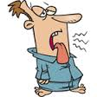
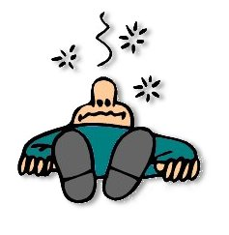
When to send to ED

Slide 4
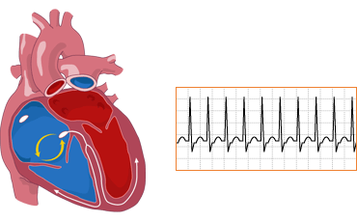
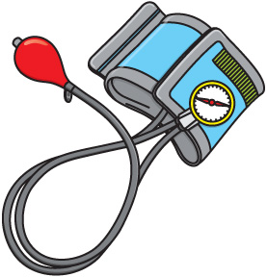
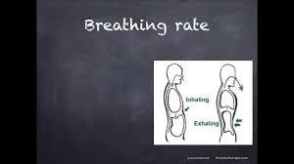
When to send to ED

Slide 5
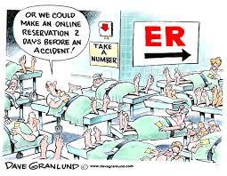
Does everyone with new afib need to go to the ED?

Slide 6
Approach
Everyone needs an EKG
Etiology (investigations)
Rate/rhythm control
Stroke prevention (anticoagulation)
Notes:
Everyone needs an echo

Slide 7
Case 1
75yr old man with history of HTN presents to the office with SOBOE for 6 weeks. No chest pain and no resting SOB.

Slide 8
Case 1
On exam:
BP 150/80 HR 110 irreg irreg RR 16
Chest clear
JVP not elevated
Heart sounds normal

Slide 9
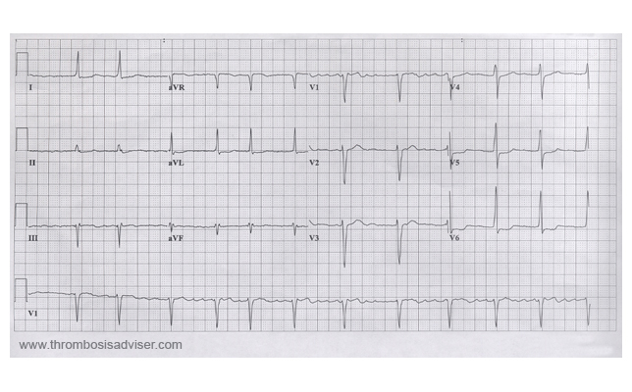
Step 1

Slide 10
Step 2
Does this patient need to go to the ED?

Slide 11
Case 1: How to manage
Rate control
target heart rate of <100
start on beta blocker or CCB
Assess risk for stroke
CHADS-Vasc
Investigations
Echo, bloodwork +/- holter
Follow up
Notes:
Consider holter
Consider stress testing because of exertional symptoms

Slide 12
Case 2
30 yr old man who presents to the office with new palpitations that started 4 hours ago.
Otherwise asymptomatic
BP 140/80 HR 150 irreg irreg RR 16

Slide 13
Case 2:
Does this patient need to go to ED?

Slide 14
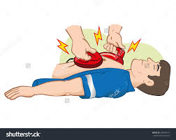
Case 2: What will you do
Notes:
High heart rate and cardioversion

Slide 15
Case 3
60 year old man with incidental finding of irregular hear beat on physical exam. He denies palpitations, CP, SOB, syncope.
Otherwise healthy

Slide 16
Case 3
Physical Exam
On exam
HR 70 irregular BP 130/80
Chest clear
JVP not elevated
Heart sounds normal, no murmurs

Slide 17
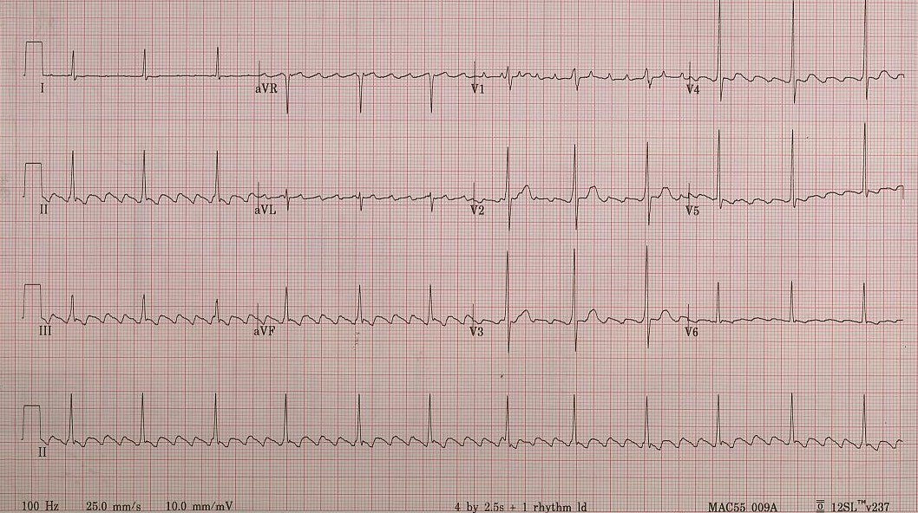
Case 3: EKG

Slide 18
Case 3: How to manage
Rate control?
not needed as HR<100
Anticoagulation?
not immediately (unless thinking about cardioversion)
Investigations?
echo, holter, bloodwork
Longterm management
Notes:
No need for rate control as heart rate < 100
Anticoagulation – no unless planning to cardiovert
Needs echo, bloodwork +/- holter
Atrial flutter – refer to EP as ablation very successful

Slide 19
Case 4
Patient went to ED with new SOB and leg swelling and found to be in afib. Trop negative. Discharged on bisoprolol 2.5 mg daily.
The patients sees you in the office and is SOB with minimal exertion. No chest pain. He also has increasing leg edema.

Slide 20
Case 4
BP 140/85 HR 115 irregular RR 20 O2 sat 95%
Chest creps at bases
JVP elevated 5cm ASA
2+ edema

Slide 21
Case 4: Does this patient need to go to ED?

Slide 22
Case 4
1. Uncontrolled afib
2. Congestive heart failure

Slide 23
Case 4
Rate control
Anticoagulation
Volume overload
Investigations

Slide 24
Case 4
In 1 week – much improved with decrease in SOB and heart rate is 95
Weight has decreased
Echo shows dilated LV with regional wall motion abnormalities – EF 30%
Next steps?
Notes:
Ace inhibitore
Assessment for CAD
Cardiology consult

Slide 25
Case 5
75yr old woman with known aortic stenosis who presents with some new mild SOB.
On exam:
BP 143/80 HR 104 RR 20 O2 at 96%
chest clear
CVS JVP not elevated
aortic stenosis murmur
EKG confirms afib

Slide 26
Case 5
Why does she have afib?
Rate control?
Stroke prevention

Slide 27
Case 5
Given the aortic stenosis which anticoagulant would you choose?
1. Warfarin
2. New oral anticoagulant

Slide 28
Case 5
Which type of valvular heart disease can you not use OACs?
Mechanical valves
Mitral stenosis (moderate to severe)
Rheumatic mitral stenosis

Slide 29
Summary
Symptoms
Signs
YES → ED
Unstable → ED

Slide 30
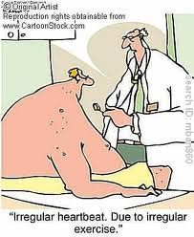
Questions

